Slide 1
Chocolate, Lego, Scrum Game Gamemaster Slides

Slide 2

Turn and Talk
What do you know about DevOps?
What is
your name?
What is
your role?

Slide 3
Your Introduction
<<Use Your favorite short introduction,
your twitter handle,
best way to contact you>>

Slide 4
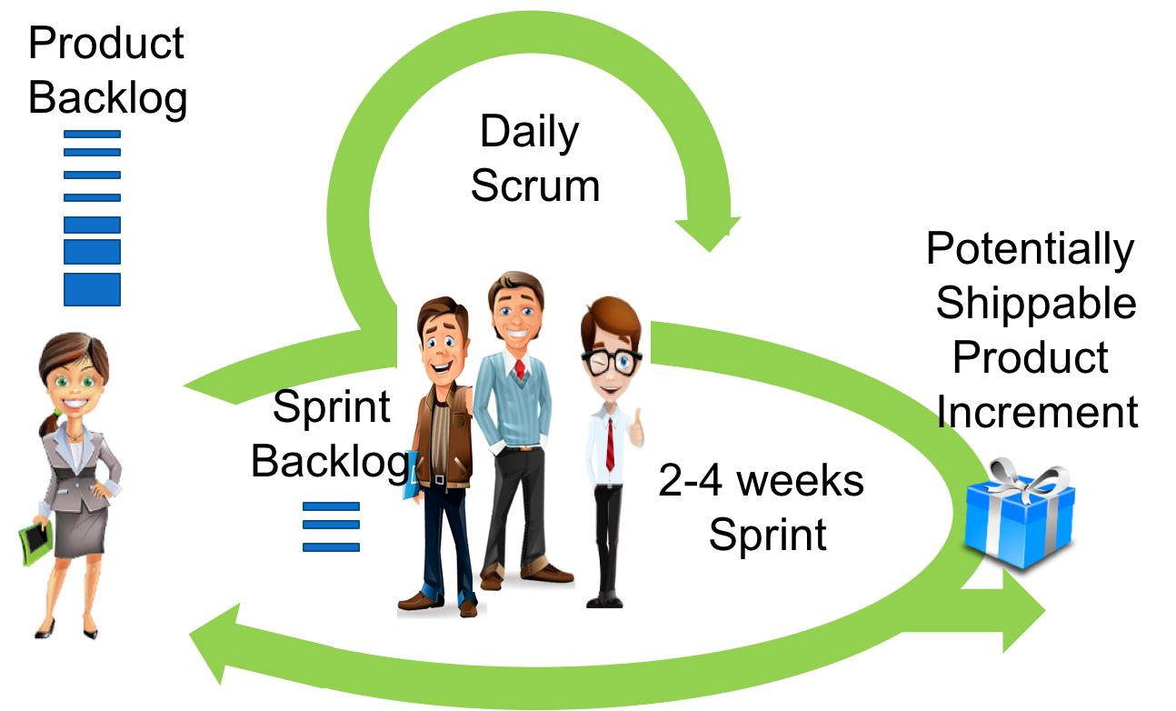






Scrum Team: Focus on Delivery and Speed
Ops Team

Slide 5

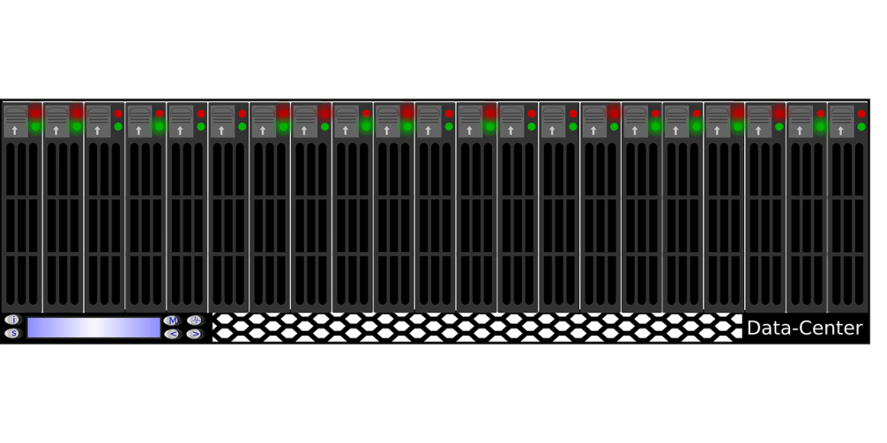
Ops Team: Focus on Stability and Reliability
Pager Duty
On-call support
Monitoring
Upgrades
Security Patching
Backups

Slide 6




Misalignment of Goals
Focus on delivery
Focus on Stability
Ever-changing demands

Slide 7



Chocolate, LEGO and Scrum Role Playing Game

Slide 8
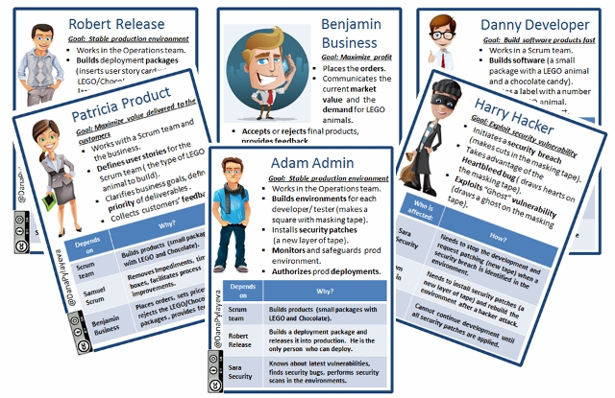
Pick Your Role and Meet Your Team

Slide 9
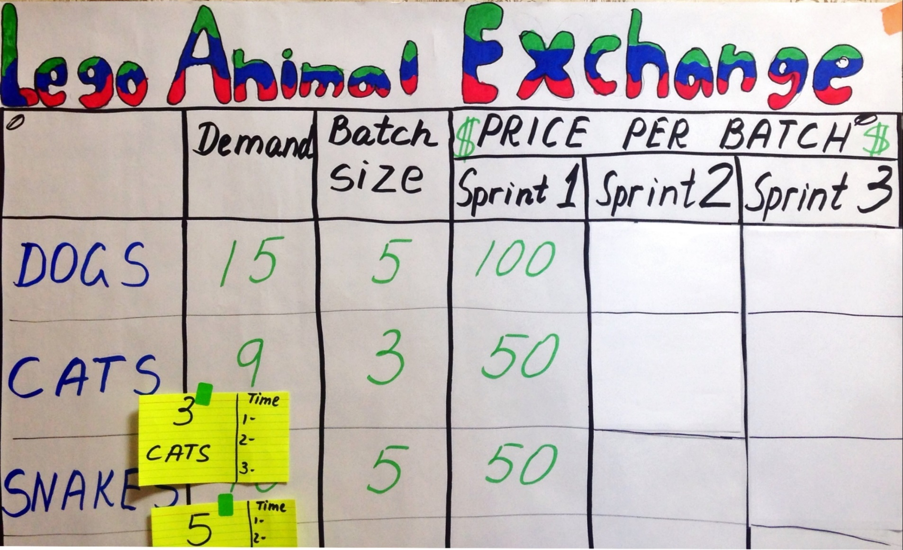
What Will You Build? Ask the Business Team!

Slide 10

Sys Admin
Builds All Environments

Slide 11

Dev Team Builds a Product

Slide 12
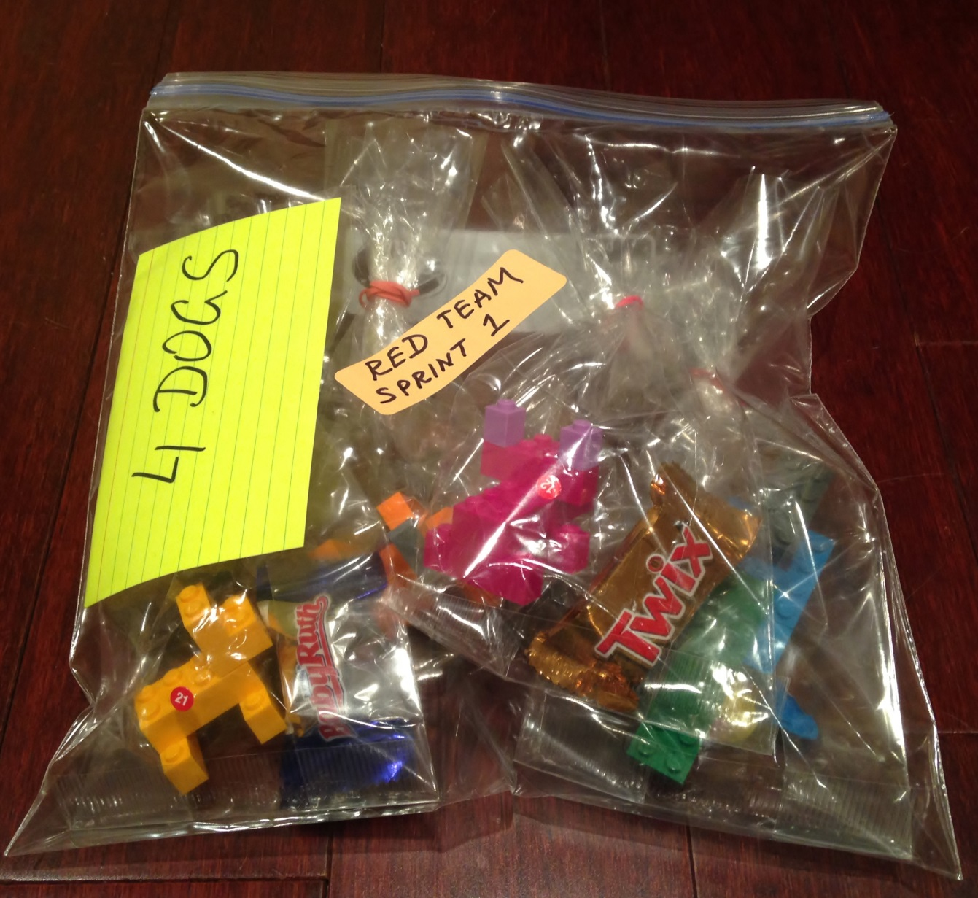
Release Engineer Builds a Deployment Package

Slide 13

Product Owner
gets paid
by the Business
when products are delivered into production.

Slide 14
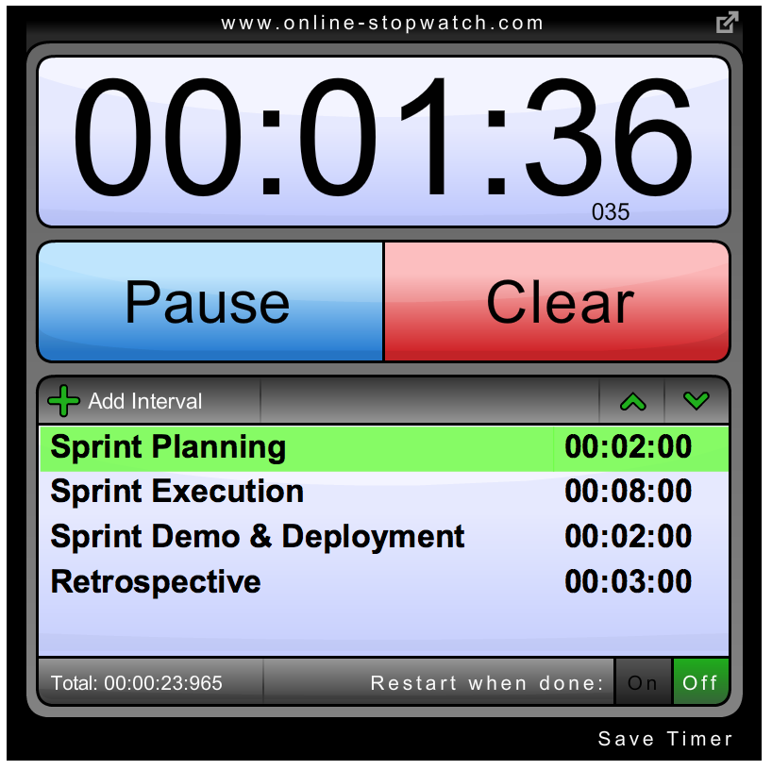
Sprint 1: Cyclical Value Delivery With Scrum
Dev and Ops are separate teams
Sys Admin controls release schedule
Security test is
at the end of the Sprint

Slide 15
What Will You Change For Sprint 2?

Slide 16
Sprint 2: Optimizing the Scrum Team
Move Security to the left - learn about security issues before implementation.
First release into production: Only Release Engineer can deploy.

Slide 17
How Was Sprint 2 For Your Team?

Slide 18
10 min Break

Slide 19
Introduction to DevOps

Slide 20
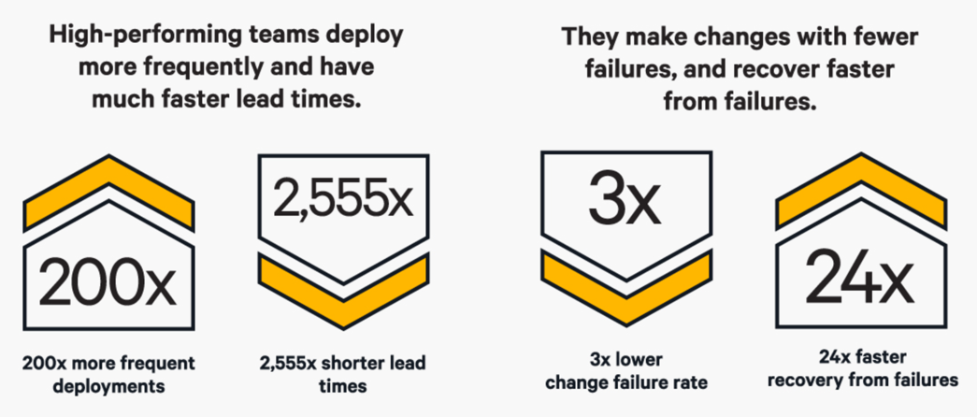
DevOps: Increased Speed
Source: Puppet Labs: State of DevOps Report 2016

Slide 21
DevOps: Increased Stability
Source: Puppet Labs: State of DevOps Report 2016

Slide 22
DevOps
“A mix of patterns intended to improve collaboration between development and operations. DevOps addresses shared goals and incentives as well as shared processes and tools.”
~ Michael Hüttermann

Slide 23

Ready for DevOps? How Do You
?

Slide 24
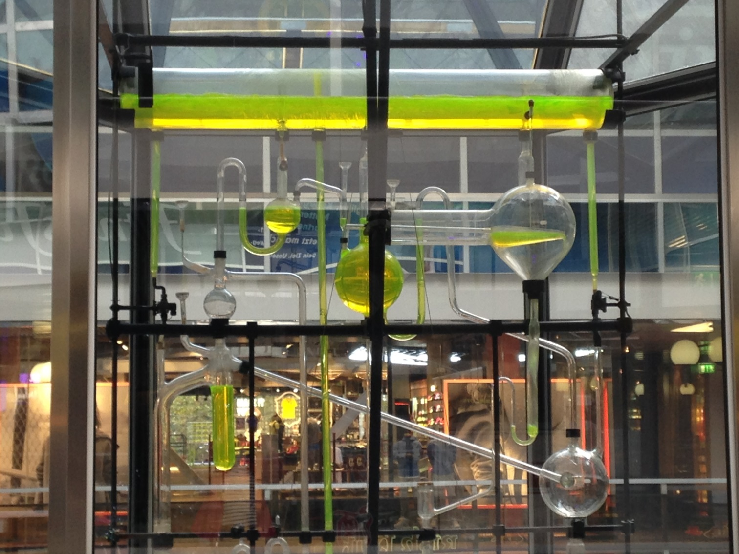
Optimize Your Flow
Where is your biggest bottleneck?
“The Phoenix Project”

Slide 25
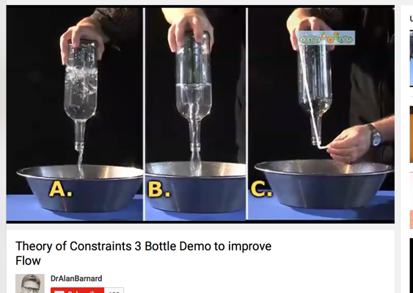
Theory of Constraints in action
Notes:
https://www.youtube.com/watch?v=PMiTVUDiNQ4

Slide 26
Enable Dev and Ops Collaboration
Dev
Ops
Scrum Team
Cross-train, Build T-shaped skills

Slide 27
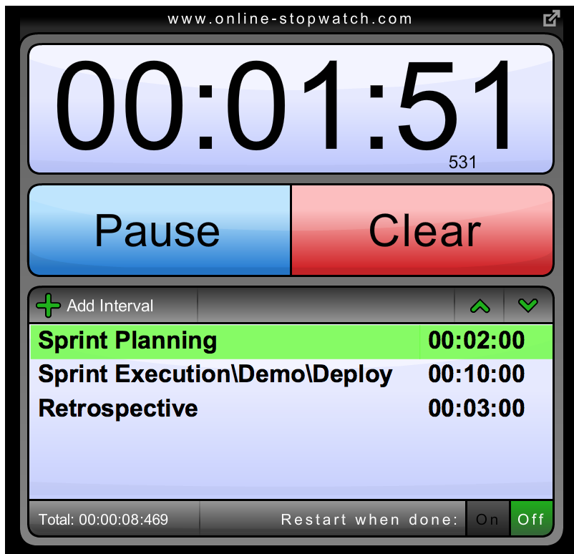
Sprint 3: DevOps Transformation.
First steps toward DevOps
Build T-shaped skills.
Automate environments provisioning– anyone can do it!
Optimize the system

Slide 28
How Was Sprint 3 For Your Team?

Slide 29

“…software development strategy that optimizes your delivery process to get high-quality, valuable software delivered as quickly as
possible…”
Jez Humble

Slide 30
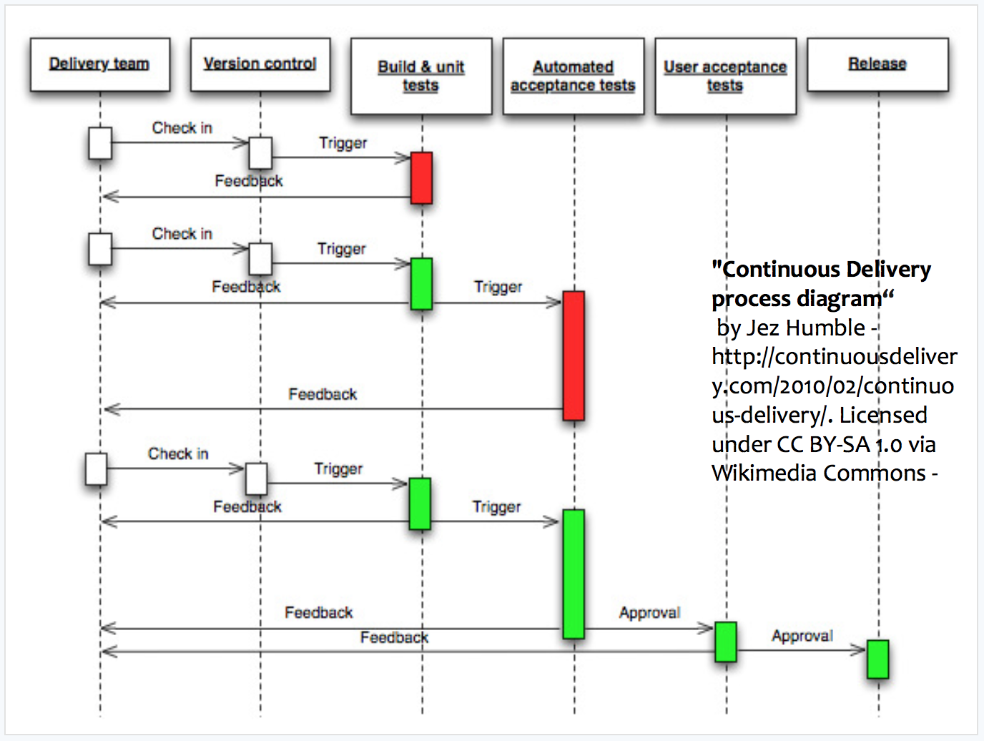

Slide 31

Split Work into Smaller Batches

Slide 32
Sprint 4: Continuous Delivery.
Reduce batch sizes.
Simplify deployment.
Implement Continuous Delivery of value

Slide 33

Fishbowl Debriefing
Five chairs.
One is always empty as an invitation.
Anyone can join.
Only people in fishbowl can talk.

Slide 34





2016 - No Longer For Unicorns Only…
Macy’s, Nordstrom,
GE Capital, Disney,
US Department of Homeland Security,
IBM, Microsoft,
Barclays Capital,
Capital One,
Target, Walmart…
2009 - 2011
Notes:
DevOps movement came a long way since 2009.
2009 – 10 deploys per day at Flickr
2011 – 11.6 sec → over 7 K deployments per day
2015 – Information from DevOps Enterprise summit. – all these companies are implementing Devops practices now and accelerating their delivery of services.
And if the Department of Homeland Security can do it, so can you!

Slide 35




Recommended Reading:

Slide 36
Links and Credits
https://www.getchef.com/blog/2010/07/16/what-devops-means-to-me/
https://puppet.com/resources/white-paper/2016-state-of-devops-report
https://blog.newrelic.com/2014/05/16/devops-name/
http://continuousdelivery.com/
https://pixabay.com/
http://vectorcharacters.net/

